Slide 1
Entertainment Law CLASS 1
Professor Yocel Alonso
Professor Justen Barks

Slide 2
Contact information / Yocel-281.240.1492. Yocel@AlonsoLaw.com
Justen—713.714.7431 Jbarks@BeardandBarks.com
(2) Personal Meetings - by appointment. Also “open”, non-recorded, non-required Zoom meetings on Fridays at high noon.
(3) Class Adjourns at 8:50 p.m.
Make-up classes will be scheduled as needed
(5) Roll Sheet / Initial / Can miss only 5 classes. Non-attendance is your loss.
Class participation = 10% of grade. May incorporate discussion areas in the final.
Skim = No test unless discussed in class.
Ask for volunteers / Advocate each side of an issue.
(6) Alonso, PLLC – Check on Fridays
AlonsoLaw.com/students
Password: CougarLaw

Slide 3
OVERVIEWS
1. Entertainment Law encompasses many bodies of law including:
Constitutional Law and the First Amendment, Copyrights, Trademarks, Tort Law, Contract Law, Statutory Law, Employment Law, Anti-trust Law etc.
Sometimes they fuse and work together “hand-in-glove” and other times it’s a train wreck, which makes it interesting and challenging.

Slide 4
2. Technology
Printing Press – 1450 (pp. 2-3)
Statute of Anne –1710

Slide 5
3. Lawyer’s Role
Don’t have to go into a traditional law practice. Many presidents are lawyers.
Clive Davis, Columbia, J. Records - Whitney Houston, Dylan, Joplin, Springsteen, Billy Joel, Aerosmith, Pink Floyd. Summer Redstone – President of Viacom.
Lawyers are involved in every aspect of the business.

Slide 6
We Take A Practical Approach to Entertainment Law
Focus on the issues you’re most likely to deal with as practitioner. Even if you don’t go into Entertainment Law, you’ll learn to identify the issues that will come up in your life.

Slide 7
Final
(1) As per syllabus. Open Book. True/False, Explain, Short Essay, and Multiple Choice. Bring all the notes you want—on paper;
(2) Take a position and defend it (Like Bar Exam);
(3) Answer the question asked. Don’t expand into areas I didn’t ask about unless you really think this helps your position (Hemingway, not Fitzgerald);
(4) One question will be answered with a one sentence answer. 10 Point Bonus if you get it right. I’ll disregard your worst answer. “Song Titles Bob Dylan’s “I Want You”/ “Hold On” – 16 times on Billboard Charts;
(5) I don’t need you to tell the difference in the cir., but you’ll get extra credit if you do;
(6) Class participation is 10% of your grade.
WHAT DO YOU WANT FROM THIS CLASS?
Fill out cards/ Email/ Blog Your Interest

Slide 8
Entertainment Law CLASS 2
Professor Yocel Alonso
Professor Justen Barks

Slide 9
(B) Sex and Violence in Entertainment Law
Mutual Film Corp. Silent Film(1915)- No 1st Amendment Protection for Entertainment. Law of the land for 40 years until THE MIRACLE, Burstyn v. Wilson in 1952. Film not accepted as a serious medium in 1915. (New Technology)
Burstyn v. Wilson - 1st Amendment Protection/ Held NY Film Board’s Prior Restraint of a film about a ravished goat herder because it was sacrilegious was held impermissible.
Some Prior Restraints – Permissible
Miller v. California – Obscenity Standards:
(1)Appeals to prurient interest;
(2) patently offensive--Professor Sullivan - “Turn you on & gross you out at the same time”; and
(3) lacks social value.
American Booksellers Assn. v. Hudnut—Group of Booksellers, Distributors, Readers and Film Viewers challenged Indiana Ordinance’s definition of “pornography,” which differed from the Miller definition and focused solely on women. The Court affirmed the district court’s finding that the ordinance was a form of “thought control” and a violation of the 1st Amendment and an unconstitutional prior restraint on speech

Slide 10
Skywalker Records v. Navarro - 2 Live Crew Case - “As Nasty as They Wanna Be”
Application of the “Average Person Standard” - Applied by District Judge who held that the lyrics were obscene. Rev’d on appeal, because there was no evidence that “Judge Dredd” could speak to whether the song lacked serious artistic value
FCC v. Pacifica (George Carlin Case) 7 Dirty Words monologue found to violate the prohibition against “indecent” language in radio broadcasts, meaning “nonconformance with accepted standards of morality.”
Repetitive Use verbal shock treatment; and (2) Context during hours when children might be listening (Oct. @ 2pm)
Distinction Between Broadcasters and Other Media, including Internet (Burstyn v. Wilson)
Technology Based Distinction - Broadcast Media’s Penetration into our daily lives
FCC v. Fox - Cher, Bono, & Nicole Richie - Holding that the FCC did not arbitrarily change its rules from the Carlin Case to the Bono Case, but leaving open the question of whether the rule was constitutional. It was presented with this opportunity because on remand the 2nd Cir. Held that the statute was void for vagueness, but the SCOTUS side-stepped it and set aside the FCC order based on the lack of Fair Notice because of the ex post facto rules. (FCC v. Fox 2)
Chronology-Importance of this issue, how will it be decided??
CHRONOLOGY
2002 – Cher BMA “So fuck ‘em!”(FOX)
Jan. 2003 – Bono “fucking brilliant” “Really fucking brilliant” (Golden Globes)(NBC)
Feb. 2003—NYPD Blue-Buttocks (ABC)
Oct. 2003---FCC Rules Bono NOT indecent
Dec. 2003 – Nicole Richie – BMA “Not so fuckin simple” (FOX)
Jan. 2004- Houston Superbowl – Wardrobe malfunction
March 2004 FCC Golden Globes order – new policy against “Fleeting Expletives” (Based on Bono Case)
March 2006 FCC issues notices of apparent liability against FOX and ABC based on GG Order

Slide 11
Prior Restraint | Obscenity | Agency Regulation
Mutual Film Corp Burstyn v. Wilson Miller v. California ABA v. Hudnut | Skyywalker Records | FCC v. Pacifica Golden Gobes Order FCC v. Fox I FCC v. Fox II
Is the statute unconstitutional under the First Amendment? | Is the speech protected under the First Amendment? (Miller Test) | Is the speech carried on licensed channels? AND Does the speech violate indecency regulations promulgated by the FCC?

Slide 12
Last Class - Docudramas = Lawsuit Magnets
Discussed Types of Programming that generally attracted lawsuits and the early theories that suits were based on: Tort vs. The 1st Amendment vs. Contracts (Hand to hand combat)
Defamation - a. public figures, b. public officials, c. limited public figures, c. private figures
Actual Malice Evidentiary Standard - Difficult to overcome for P – required for public anything and exemplary damages for private figures
Davis v. Costa-Gavras – Docudrama – Pinochet coup – Main issue was “of and concerning,” and actual malice. If scenes were not made with serious doubts of the truth of the televised composite, they were not actionable. Costa-Gavras reasonably relied on the Execution of Charles Horman and the research undertaken by Hauser.
Dickinson v. Cosby – statements by Bill Cosby’s lawyer that Plaintiff “lied” about sexual assault by Cosby in presser and demand letter were actionable. Under the totality of the circumstances, including application of the “predicable opinion doctrine” (CA) would lead listeners to believe the statements made by Cosby’s attorney were not mere opinion.

Slide 13
ANTI-SLAPP PROCEDURE:
Plaintiff sues
Defendant moves to dismiss under STATE anti-SLAPP statute
a. Identify that the cause(s) of action directed at a first amendment right (speech, assembly, petition)
b. Identify that the actions of Defendant were a matter of public concern (limited in TX)
Burden shifts to Plaintiff to demonstrate that the cause(s) of action actionable and “probability of success” on the merits based on
a. Legal sufficiency
b. Factual sufficiency
Texas Citizens Participation Act (TCPA)— Exemptions for commercial speech and media.
“Matter of public concern” is very narrow
see Vaughn-Riley v. Patterson (website)

Slide 14
2. Looked for another weakness in the Death Star –
Falwell v. Hustler – Claimed Intentional infliction of emotional distress; differs from defamation in that the injury is personal rather than a matter of reputation in the community (how I feel v. how others feel about me)
STILL had to show actual malice for public figure. Bad motive not enough.
Contract Law –Kept CBS from airing story on Brown & Williamson whistle blower Jeffery Weigand, who had signed a Confidentiality Agreement. Private agreements to limit speech will be enforced (e.g. EE agreement, NDA) (pp. 156-57)
3. Privacy/Misappropriation of one’s name and likeness –
Evolution:
Warren/Brandeis Right of Privacy (1890)
Pavesich (Ga. 1905) outlined four causes of action … (4) appropriation of name and likeness BUT use of photograph in an advertisement was a violation of Ga. common law right of privacy
Haelan Labs (2d. Cir. 1953) first case to recognize the economic/utilitarian nature of right of publicity

Slide 15
Heller v. NBCUniversal – NBC used the California SLAPP Statute to obtain the dismissal of most of Heller’s defamation claims because the Court found that they were not actionable.
MLK v. American Heritage Products - Appropriation of another’s name and likeness for the economic/financial gain of the appropriator is a tort in Georgia - Bust of MLK – a generic symbol; Concurrence: where do we draw the line? What constitutes financial gain? Is it true that commercial use is not speech?
ETW Corp. v. Jireh Publishing (Tiger Woods Case) - Art print entitled to 1st Amendment Protection because: (1) Portrayed a historic event; (2) Included other golfers; (3) Defendant added a “Significant Creative Component of his own.” Dissent - Nearly identical to Nike poster; The new work is “transformative”; the new work incorporates independently expressive and protectable elements.
Zacchini v. Scripps-Howard (Human Cannon Ball 1977 Case) - Distinguished the torts of Right of Publicity with false light invasion of privacy and the others—First Amendment is NOT unlimited. Minimize Publication v. Who Gets to do the Publishing. Misappropriation based on broadcast of the entire act. Broadly defines ROP as incorporating not Zacchini’s identifiable name, image, likeness, but the act he is associated with (compare to INS v. AP’s pre-Eerie Doctrine misappropriation analysis)
THIS IS THE ONLY SCOTUS CASE ON THE RIGHT OF PUBLICITY.

Slide 16
Limits on the Right of Publicity
Right of publicity does not prevent parody by others. But imitation is not parody. KEITH RICHARDS: Imitation is the sincerest form of being ripped off.”
The right extends from where the plaintiff is domiciled when exercising the right. A plaintiff cannot avail itself of the right unless he or she had it in the first place.
The Right of publicity also can’t be used against someone who makes legitimate mention of public activities in a book or movie - Matthews v. Wozencraft - Court made reference to the concept of “Fair Use”. Star-crossed Drug - Addicted lovers who fell out over the movie “Rush”
Hicks v. Casablanca Records (Agatha Christie Case) - The court held that the 1st Amendment again trumped the Right of Publicity in a work of fiction where the names of actual people were used as “Mere appendages to the main body of their fictional accounts” and it was obvious that it was a work of fiction.

Slide 17
Tony Twist Case, John Doe a/k/a Tony Twist v. TCI Cablevision/Todd McFarlane - Infamous hockey player enforcer sued the creator of the Spawn Comic Book for the inclusion of a character by that name who murdered and abducted children. Court held that the Twist name was used as a “Ploy to sell comic books” rather than an artistic or literary expression, and held for the Plaintiff. Comics not taken seriously. “Predominant Use” Test vs. the “Transformative” Test
Winter v. D.C. Comics, 30 Cal. 4th 881 (Cal. Sup. Ct. 2003). Decided within 2 months of Twist. Another comic book case where the “Transformative” test was applied & ct held that the Jonah Hex Comic Book was entitled to 1st Amendment Protection. Creative Element: “Significantly transformed the celebrity depiction.”

Slide 18
Carson v. Here’s Johnny – (1) No trademark claim because no likelihood of confusion; (2) Court held that Right of Publicity not limited to name and likeness - No Confusion “Here’s Johnny” = Misappropriation of Carson’s identity and Publicity Rights. “Ploy to Sell Toilets” – Paraphrasing Tony Twist. Defendant admitted that phrase identified with Carson and that’s why it was used.
White v. Samsung Elect
(1) Robot dressed in a wig held to resemble Vanna White, context must be considered and (2) No laundry list for misappropriation. Dissent by Judge Kozinski that under this ruling
(a) anything that reminded the public of a celebrity = misappropriation; and
(b) Inherent conflict with the copyright law. $400K Settlement.

Slide 19
Comedy III Prod. v. Saderup (3 Stooges Case) – Posters and silkscreens. Misappropriation of the Right of Publicity.
(1.) Right of Publicity covers rights not protected by copyright.
(2.) Court held that the posters were Not Transformative and therefore not entitled to 1st Amendment Protection.
MLK v. American Heritage Products - Holding that the Right of Publicity survives the death of the owner in Georgia and compared this to the laws of other states, including Texas where this is Statutory. (50 ears after death) Indiana - 100 years - Protests gestures & mannerisms.

Slide 20
Texas Publicity Rights:
Common Law
Name or likeness of living persons
Includes “identity”
No life story rights
Statute (“Buddy Holly Bill”)
Starts at death
Creates a descendible right for valuable personalities
Name, voice, signature, photograph, or likeness
May be transferred before death
If not transferred, vests in surviving spouse or heirs
Must register with SOS

Slide 21
NCAA NIL
As of July 1, 2021:
Interim policy which allows student athletes to leverage NIL, but
NO pay-for-play
NO inducement
Existing state framework governs
Texas Leg passed SB 1385, eff. July 1, 2021
Tex. Educ. Code s. 51.9246(f)
Applies to “general academic teaching institution” and “private or independent institutions of higher education”
Cannot adopt or enforce a policy preventing exploitation of NIL, including representation, solicitation, procurement, or earning
Cannot disqualify student from scholarships or financial aid if additional compensation is earned through exploitation of NIL
Students must disclose contracts for use of NIL
Contracts shall not conflict with team contracts
Contracts may not compensate for NIL in connection with:
Pay-for-play
Property owned by institution
Alcohol, tobacco or other nicotine delivery, steroids, sports betting or gabling, firearms the student could not purchase, or sexually oriented businesses

Slide 22
Misappropriation of Right of Publicity Analysis
Is a right of publicity implicated?
NIL, indicia of personality
Can we argue that the indicia of personality is not tied to commercial value of the individual?
Is the right of publicity misappropriated (see Matthews v. Wozencraft for elements)
In MO – is the NIL the “predominant means” of the value of the commercial product? Is use of NIL simply a ploy to sell stuff?
Did they take more than their fair share? (Zacchini)
Defenses
First AM - parody, comment criticism
Transformative - includes significant additional creative elements, does not supplant the commercial value of NIL, NIL is part of the tools to create something new

Slide 23
COPYRIGHT
COPYRIGHT PROTECTION – Basis for Copyright Law, Foundation for the Entertainment Industry
Art. 1, S.8, Cl. 8 - protect for limited times, useful arts and sciences
“Sciences” has expanded over time to really mean creative works of authorship No longer just maps and books…
Anglo-American v. Continental Copyright – US copyright system developed from UK book publisher monopoly laws (Statute of Anne); US system is industrial in nature and driven by the utilitarian bargain: economic incentive to create balanced by public interest in use – we value the public domain and fair use rights.

Slide 24
Copyright Covers: “Original works of authorship fixed in a tangible medium of expression.”
Original
Feist Publications v. Rural Telephone Service – Telephone book case; rejects “Sweat of the Brow (misappropriation) Theory” in holding that a list of names and phone numbers not copyrightable; in dicta Court suggests there may be a way to come up with arranging a list of names in an original way, but won’t likely be useful.
Bleistein v. Donaldson - Justice Holmes held that posters were copyrightable and introduced the concept of non-discrimination. Statute’s “originality” requirement no minimum threshold for aesthetic quality; is dangerous for Judges to become the arbiters of the worth of a work of art (see, Skywalker; ETW (dissent))
Works of Authorship
Can’t be a monkey. Also can’t be AI (Dall-E, MidJourney, etc.).
Fixation-- – “Fixed in a Tangible Medium of Expression”
Horgan v. Macmillan – (Nutcracker Case) Fixation requires the work to be capable of being perceived, reproduced, and communicated; Court held that photography of ballet dancers sufficiently “reproduced” Balanchine’s choreography by capturing and fixing the composition of the dance and freezing choreographic movement.

Slide 25
Copyright Covers: “Original works of authorship fixed in a tangible medium of expression.
Of Expression
Miller v. Universal City Studios – Miller wrote a book, Universal made a MOW allegedly based in part on the book, unlike Costa-Gavras no license; Dist. Ct. stated that the book was the expression of the research in and to the facts, such research was protected. 5th Circuit reversed and remanded on incorrect jury instruction: Copyright protection does not extend to history or research, and research is a stepping stone to the expression—not the expression itself.
INFRINGEMENT
(1) Requires copying, unlike Patent Law. Duplication not enough
(2) Must establish access to the protected work and Substantial Similarity(Undue Similarity).
(3) Striking similarity may also be used to prove access
(4) No intent required (strict liability). BUT without access can have similar and protectable works created independently
Bright Tunes v. Harrisongs - My Sweet Lord / He’s So Fine (Chiffons)
Court compared the music, Defendant’s expert admitted he’s never come across the unique motifs sequence of the music, including the “Grace Note” and court held that Harrison had subconsciously copied—Harrison was in England when HSF was a #1 hit
Belmonts – My Sweet Lord, substitutes “Dulang” and “He’s so Fine” for “Hallelujah” and “Hare Krishna.” Harrison admitted “Substantial similarity,” and couldn’t recall how he composed the song.

Slide 26
Three Boys Music v. Bolton – Same result, even though it was 25 years between the release of the 2 songs. Bolton told Ronald Isley that he had all of his music.
Selle v. Gibb – Bee Gees Case( 7th Cir.). Composer sent a tape of his songs to record company. - Court held that inference of access may be established by proof of striking similarity. However, Plaintiff’s proof fell short. Expert failed to say that similarities resulted only from copying, no other proof of access, and no impeachment of Defendant’s witnesses.
Difference in Circuits – 7th and 9th Circuits require either ind. proof of access or striking similarity with the reasonable possibility for access. Other circuits do not, “Striking Similarity” is sufficient.
Substantial Similarity in Books, Plays, & Movies
Nichols v. Universal Pictures – Judge Hand established the “Abstractions Test” for Copyright Infringement. The more abstract the work → Idea, Less Protection. The less abstract, the more it becomes eligible for protection.
Play v. Movie – “The Cohens & The Kellys” p. 366 (Upside down Pyramid)

Slide 27
Denker v. UHRY – (Driving Miss Daisy) – Allegation that movie infringed on the Plaintiff’s Novel. Court applied abstractions test and held that while there were general similarities and the theme was the same, the expression was different. The works had a different concept and feel. General plot devices and Scenes-A-Faire not protectable under Copyright. Elements that are standard in the treatment of a given topic (Slaves Pursued by Dogs/ Zorro picks off the posse from the back)
Beal vs. Paramount – (Coming to America) – Plaintiff claiming that the movie infringed her book, but court held for Defendant in a Motion for Summary Judgment because the copyrightable elements of the work were not copied.
Fink v. Goodson-Todman (Branded Case) <Structural Spine> Here the Plaintiff alleged that the show infringed on his proposed program. The court agreed and reversed Motion for Summary Judgment based on implied Contract and Substantial Similarity. Plaintiff had submitted his program to Defendants and their request. Big Lebowski - Dude

Slide 28
Scenes-a-faire!
“Similarity of expression . . . which necessarily results from the fact that the common idea is only capable of expression in more or less stereotypical form will preclude a finding of actionable similarity.” Melville B. Nimmer
- merger doctrine meets the abstractions test
- does not have to be genre, trope, or repetition. a work can incorporate a scene-a-faire in an original way for the first time with a single use
Characters – Not specifically referenced in the Copyright Act, but held protectable by the courts. Judge Hand applied his abstractions test in Nichols v. Universal Pictures(2nd. Cir._. The 9th Circuit denied Copyright application for Sam Spade (Maltese Falcon), but held protected if character is the story. Dashiell Hammett
Warner Bros v. American Broadcasting – (Superman Case) – Held that although Superman entitled to Protection because he presents more than a “Benevolent Hercules,” Copyright would not extend to every “Superman” who was a blessing to mankind, here the similarities were too general and the court held no Substantial Similarity or, alternatively, “Hero” was a Parody.

Slide 29
Fair Use (codified 1976 Act) – Factors under §107 of the Copyright Law, which did not supplant the Common Law, only Codified it. Not intended to change, narrow or enlarge the doctrine. Like the common law, statute doesn’t tell us how to apply or weigh them.
Harper & Row Case (1985) – Gerald Ford Autobiography – Use 300 words out of 300,000 held not to be Fair Use where:
(1) Unpublished
(2) Most significant part of the Book;
(3) Had not been obtained through appropriate means/ surreptitiously obtained
§107 Amended to make clear that just because a work is unpublished does not in and of itself bar a finding of Fair Use.

Slide 30
Campbell v. Acuff-Rose (1994) – Luke Skywalker/ 2 Live Crew/ Roy Orbison’s Pretty Woman. Plaintiff refused a license but Defendant used the song anyway and court granted Defendants’ Motion for Summary Judgment. SCOTUS analyzed the Parody fair use defense based on the 4 factors in §107.
(1) Purpose and character of the use - Parody is transformative and the Commercial Nature of the work not dispositive.
(2) “The Nature of the Copyrighted Work” --basically irrelevant in Parody cases
(3) “The amount and substantiality of the portion used in relation to the Copyrighted work as a whole.” Court found that No More Was Taken Than Was Necessary, but that Parody must be able to “Conjure Up” the Original / “Aims at the Heart of the Original” and turns the O “inside out”
(4) “The Effect of the Use Upon the Potential Market for or Value of the Copyrighted Work” Court made a distinction between usurpation and suppression of demand, BUT found that there was a factual void in the record regarding the market impact for Derivative Rap Covers and remanded the case. Most Impt. Factor under the cases.

Slide 31
Sony v. Universal (1984)– Reversed 9th Circuit 5/4 ruling (Brennan & O’ Connor changed their votes so it went from 6-3 to affirm to 5-4 to reverse) where the court noted that Sony’s Betamax was:
(1) a copying technology;
(2) marketed for the purpose of time-shifting by consumers - not a commercial use;
(3) minimal harm to the market;
(4.) Fair Use => Sony not guilty of Contributory Infringement. “Copying Technology just needs to be capable of Substantial Non-Infringing Uses.” 91% of files copyrighted (9% legal copying)
Did Harper Row overrule Sony?
No, Harper Row does narrow the fair use test, including infringement for unpublished works and limiting the “amount and substantiality factor”
Did Acuff-Rose overrule Sony?
Acuff-Rose says “No” – “Sony didn’t call for a hard evidentiary presumption”
SCOTUS explained that the Court of Appeals erred on its interpretation of Sony that the “Commercial Nature” made 2 Live Crew’s use “Presumptively Unfair”.
However, the consensus is that Acuff-Rose overruled Sony on that point.

Slide 32
A & M Records v. Napster (9th Circuit 2001) – Napster thought it had gotten around the MP3 problem by not making copies itself but by making the technology available to do so. However, the download requests were handled through Napster’s server, this involved the simultaneous distribution of Copyrighted Music to the general public. The court did not find error in the District Court’s refusal to look at evidence that Napster actually increased the Plaintiff’s sales, analogizing this to the infringement by a film producer’s use of a song in a film. Basically, a Copyright owner has the right to shoot himself in the foot. Discussion of Secondary Liability, both vicarious and contributory.
Fonovisa Case - Defendant cannot “knowingly avoid knowledge” Sargent Shultz defense (willful ignorance)
Held that Napster both vicariously liable and guilty of contributing to infringement, but modified the injunction to require that Plaintiff provide notice to Napster of their works “Before Napster has the duty to disable access to the offending content.” (Only 87% files Copyrighted vs. 91% for Sony)

Slide 33
MGM v. Grokster (2005) - 3-3-3 Decision (S. Ct.)
Dealing with Second Generation Software, allowing that download requests NOT go through a central server (Thought it solved the Napster problem). Court held that one who distributed a device with the object of promoting its use to infringe Copyright is liable for the infringement by Third Parties. Wrongful inducement C/A.
Court found that Grokster:
(1) Wanted to benefit from Napster’s misfortunes;
(2) Stated goal was to “Get in Trouble with the Law” and
(3) Principal object was downloading of Copyrighted works and took active steps to encourage it;
(4) Did not attempt to develop filtering tools and
(5) Business model “Profited” from infringement. Court found Grokster contributorily liable, but did not reach the issue of vicarious liability. Agreed that Grokster was a “Bad Guy”
Lenz v. UMG (9th Cir.) Dancing Baby case / Prince song. Held that copyright owners had to form a subjective belief that the use was not authorized, taking fair use into account.

Slide 34
Capital Records v. Redigi (District Court) – Service that earns a fee from the re-selling of digital music violates copyright, where it reproduces the music in a new material object in order to provide this service.
ABC v. AEREO (S. Ct. 2015) – Aereo’s service of providing centralized servers, transcoders, and dime-sized antennas for the public held a violation of the public performance right. DUCK PROBLEM.
NO INFRINGEMENT – Sony - Campbell
DIRECT INFRINGEMENT – Redigi – Aereo
(3) WRONGFUL INDUCEMENT ONLY – Grokster
(4) CONTRIB. & VICARIOUS – Napster – Fonovisa

Slide 35
Performance Rights in Songs
Traditionally, Copyright for Songs, which included the public performance of Music. No Copyright for recordings until 1971, but as of 1995 does exist for digital transmission.
(Digital Performance Rights in Sound Recordings)
ASCAP & BMI – Music Cops – Collect money from venues, bands still responsible
Payola Statute §508 of the Communications Act – EEE can’t accept money or other valuable consideration for Play. Payments must be disclosed before or after a song
Compulsory Mechanical License – 37 CFR §201.19
(1) Monthly Statements;
(2) Annual Statements certified by CPA
Digital Sampling - “Thou Shalt Not Steal” Warner Bros. Case – Made a Criminal Referral
Jarvis v. A&M Records - Sampling / “Fragmented Literal Similarity” – “Digital Copy”
Literal Verbatim Similarity between the works
Test for Substantial Similarity = “Response of the Ordinary Lay Person”
Liability exists when the “Segment constitutes a substantial portion of the Plaintiff’s Work.”

Slide 36
Copyright Ownership – Author = Owner
(A) Works for Hire = E-EE of Company or Independent Contractor Agreement with non-EEE must be in writing.
Community for Creative Non-Violence v. Reid – Sculpture Case – Where Artist claimed ownership even though no written agreement with the Plaintiff, which commissioned it. Court held NOT a work made for hire under §101(2).
Court applied Common Law to determine whether Defendant is an E-EE. Court held that Defendant not an E-EE and remanded the case to determine whether Plaintiff qualified as a Co-Author. Settled with Consent Judgment.
Casebook also referenced the Aymes Case which held that how a company treats a person vis-a-vis emp. fringe benefits is a very important factor. In every case where no SS taxes or benefits paid by the Company, the person found to be Independent. Contractor. NOT the sole factor to be considered, but very important.

Slide 37
(B) Joint Authorship – Joint work defined in §101 – A work prepared by 2 or more Authors with the intention that their contributions be merged into inseparable or interdependent parts of a unitary whole.” Both contributions must be Copyrightable. Must be mutual intent of Joint Authorship.
Contract can determine Ownership
Copyright Licensing – §204 requires a written agreement for transfers and exclusive licenses. NOT non-exclusive licenses, which can be oral.
Cohen d/b/a Bizarre Music v. Paramount (p. 483) – Synchronization license granted for movies, but not video cassettes. Court applied the Contract language and reversed
Summary Judgment for the Defendant Typical Contracts Cover Future Uses and New Media.

Slide 38
Copyright Term Law Changed in 1998, Life plus 70 years or 95 years for Corporations
Challenged in Eldred v. Ashcroft as violating the “Limited Time” phrase of Art 1, Section 8, Clause 8. Supreme Court held that the change was necessary in order to give American Copyright Holders the same duration as Authors in the European Union, over vigorous dissents that there was no rational basis for this change.
Enforcing Copyright – Lawsuits for damages, impoundment, injunctive relief, and attorneys’ fees
(A) Damages
Gaste v. Morris Kaiserman Case (P. 511) “Feelings” Case – Court affirmed a jury award for $403k, substantially larger than the $15K revenues earned by the song in 25 years, based on the Defendant’s revenues.
Apportioned the income and only took a 12% deduction for the Defendant’s contribution to the lyrics vs. 25% deduction in Harrisongs
(B) Attorneys’ Fees – Also allowed to the prevailing Plaintiff or Defendant - Discretionary Fogerty v. Fantasy (P.516)- Fogerty accused of infringing his own song, prevailed, and was awarded attorneys fees under §505, even though the same language was held not to support attorneys fees for defendants in civil rights cases.

Slide 39
(A) Artistic Credit - Starts with Unfair Competition(Umbrella Term) and the Lanham Act §43(a) USC §1125 which provides protection for Authors and Artists to receive proper credit for their work.
Smith v. Montoro – Actor’s name was removed from screen credits and credit given to another actor. Court held this to be “Reverse Passing Off” and a violation of the Lanham Act.
Court discussed the different ways that passing off can occur
IRONY – Even though it is stated policy of Trademark Law to avoid consumer confusion, consumers don’t have standing.
P.O. R.P.O. Implied RPO
Rolex Name Stolex–bogus name No name
| | |
Bogus Stolex Product Rolex Product Rolex Product
Lamothe v. Atlantic Recording Corporation – 2 Co-Authors not credited on the music and lyrics of 2 songs. Court held:
(1) No Trademark Registration required;
(2) This was reverse passing off;
(3) Partially correct designation of a product’s source not sufficient; and
(4) Licensees also liable. If they had knowledge of the falsity of the designation of origin
.

Slide 40
(B) Moral Rights and Creator Control
Berne Convention protects moral rights, allowing Author to object to any distortion, mutilation, or modification of the work which would be prejudicial to her honor or reputation Accepted by U.S., but not moral rights language, because “U.S. already protected” 7th Circuit - No moral rights in absence of statute
Granz v. Harris – 8-minute cut from the Plaintiff’s recording, who successfully sued to block the release of the recordings because, Pursuant to His Contract, the Album had to state that it was “Presented by Norman Granz.” Held to be “Passing Off” decision not based on “Moral Right.” (Defendant claiming it’s a Rolex, but not a Rolex)
Preminger v. Columbia Pictures – Plaintiff’s right to make final cut did not include right to object to changes made for TV Exhibition, where the common practice and usage was for these changes to be made. No Mutilation.

Slide 41
Gilliam v. ABC (Monty Python) – 24-minutes deleted by ABC from the shows. Since Monty Python had specified the procedures for alterations in its Contract, the court held that the licensee was bound by these procedures and violated them.
Unauthorized Editing = Copyright Infringement
Mutilation = Violation of Moral Rights (Dicta)
Concurring Opinion -
(1) No Moral Rights in Copyright Law
a. except VARA, 17 USC s.106A – “work of visual art”
b. s. 101 defines “work of visual art” – PGS or photography for exhibition, 200 or fewer copies, signed, consecutively numbered
(2) Obligation to credit the Author and not make changes = False Attribution (Based on Implied Duty) (Citing Granz v. Harris)

Slide 42
Trademark Law
§1125 of the Lanham Act defines Trademark as “Any word, name, symbol, or device.... used by a Person....to identify or distinguish his or her goods...”
BUT, also subject to First Amendment exceptions: “Nominative Fair Use” is use of a trademark to describe a mark holder’s product that (1) requires the use of the mark to readily identify the goods or services; (2) uses only so much of the mark as necessary to identify them; and (3) does not imply endorsement, affiliation, or sponsorship between the mark holder and the fair user.
Rogers v. Grimaldi – Titles of works may be protected if they have acquired secondary meaning (tm); Rogers Test: use of a titles subjects the user to liability where a) the Defendant’s title has no artistic relevance to the underlying work or b) even if they have some relevance, the Titles were explicitly misleading as to the source and content of the work. But Trademark can’t be used to protect a person as a substitute for copyright infringement.
Differs from predominant use test: though often misapplied, only assoc. with titles; focuses on consumer confusion, not limited to publicity, not about the nature of commercial use

Slide 43
Dastar v. 20th Century Fox Case – (Eisenhower’s Memoir - “Crusade in Europe) - Copyright on the book was renewed but not the TV Series. Court held that Trademark Law could not be used to create a permanent Copyright. (Really a Copyright Infringement Claim)
Hormel Foods v. Jim Henson – Court held that there was no Trademark violation by applying the 8 Factor Polaroid Test; Trademark Law also can’t be used to prevent “Fair Use” based on parody, and parody is inextricably intertwined with several of the factors.
Most important factors for the Trademark Office in an ex parte review of “likelihood of confusion”: (1) similarity of the marks in terms of sight, sound, meaning, and commercial impression; (2) similarity of the goods/services

Slide 44
Boston Prof Hockey v. Dallas Cap & Emblem – Indicating that goods are “unofficial” doesn’t avoid the problems with infringement. “The argument that confusion must be as to the source of the manufacture of the emblem itself is unpersuasive where the TM, originated by the team, is the [reason for the sale of the goods.]”
BAA v. Sullivan – TM not a “right in gross” but there is a “reasonable zone of expansion”; Boston Marathon organizers could prevent sale of products designed to “link” infringer’s goods to the Marathon
BUT! WCVB-TV v. BAA – (Breyer) Channel 5 was not running or organizing the marathon, they were preparing their own news coverage of the race; consumers were not likely to believe the telecast was officially associated with BAA or authorized by them. Trademarks give a right to prevent confusion, not a property right in a mark, symbol, or device.
Browne v. McCain – Trademark | Copyright Case
Jackson Browne sued for copyright and Trademark Infringement over the use of his song in internet campaign commercial. The court denied the RNC’s Motion to Dismiss on either ground, finding (1) commercial doesn’t mean what you think it means (not limited to $$); (2) just because it is a purportedly “noncommercial” political commercial (?) doesn’t mean it is an artistic work that trumps Lanham Act rights (should be looking for some transformative/fair use here); (3) that the RNC failed to establish that plaintiff could not show a likelihood of confusion too early in the proceedings to decide these issues.

Slide 45
Federal Dilution Act of 1995 – Even when there’s no competition or consumer confusion, Defendant can be liable for the “lessening of the capacity of a Trademark to identify and distinguish the goods and services.”
Texas Anti-Dilution Stat - “Likely to injure a business reputation or to dilute....”
§16.29 B&C Code. Broader than the FED. Statute:
(1) C/A for dilution, not just Injunction
(2) Just have to show “Dilution of the Distinctive Quality” of a Mark
Hormel II - Court also held no dilution, either by blurring or tarnishing. This was a trial to the court.
This is an issue that comes up repeatedly in the context of Sports Branding –
5th Circuit Case – Boston Professional Hockey Association v. Dallas Cap & Emblem, holding that sports team name and symbols must be authorized –

Slide 46
(D) Contract Rights in Story Ideas
“Desny” Claims – Implied Contract claims by Authors against movie/tv show producers
Desny v. Wilder (p. 705)– Billy Wilder’s secretary advised Desny to prepare a synopsis of the story and submit it. Summary Judgment for Defendant was reversed based on implied Contract Theory, holding that ideas can be protected by Contract. $14,350 settlement.
To maintain a Desny claim, do not have to show that the idea is novel or concrete.
BUT NY requires that the idea be novel to the Buyer (Nadel case p.595-96) —Sotomayor opinion). C/F 3rd Circuit(applying NJ law) - Held in Baer v. Chase, the Sopranos Case (p.596)that Desny claim, can’t be used for idea in the public domain. Lots of negative history.
Defenses to Desny claims, include:
(1) No access or similarity
Independent Creation - Can be overcome by showing a “striking similarity” between the works

Slide 47
Buchwald v. Paramount - Involved the violation of an Express Contract where Paramount made a movie “Based Upon” Buchwald treatment. Court looked at Paramount’s access to the work and its similarity. Held that “Based Upon” = Based on a “Material Element” of, or was inspired by, Plaintiff’s work.

Slide 48
Inverse Ratio Rule - “The greater the access, the less similarity required”- Criticized and NOT the majority rule today, but still the rule in some jurisdictions, so be aware of it.

Slide 49
(A) Contract Formality in the movie world – Many deals based on a handshake or deal memo of questionable legal effect.
(1) Oral Contracts and Star Lawsuits
Oral Contract in the Basinger/Boxing Helena Case that surely would have been a Blockbuster on par with The Hunger Games had Basinger not pulled out of her oral agreement.
Court found sufficient evidence to support breach and large verdict, reversed on appeal based on the Jury Instructions, then settled.
Best Practice – Require written Contract before filming begins
(2) Statute of Frauds – if Contract can be completed within 1 year, no written agreement is required
Exception = Promissory Estoppel
Also, loan-out companies are real and very useful; try to wrap the individual actor/artist into the contract by other means (e.g. indemnification)

Slide 50
Alexander v. MGM – Twitter Fail. Can’t shout your unprotected idea into a room and get upset that you’ve lost your exclusive rights! No evidence of acceptance or that Plaintiff would receive any compensation; no terms to imply
Elvin Associates v. Aretha Franklin Case - No Contract claim, but the Plaintiff reasonably relied to its detriment on Aretha’s promise to perform. Aretha had knowledge of the Plaintiff’s investment in reliance on this promise. (Don’t tell Olivas)

Slide 51
Gold Seal Productions v. RKO Radio Pictures - Oral film contract enforced, based in part on the Parties’ Agreement on a previous film. Just because the parties have said they will enter into a written Contract to follow does not mean that a previous oral agreement won’t be enforced.
Yocel’s Language: Of course, this email and any future communications that we may have about this proposal will be considered and used for settlement negotiations only and will not be used for any other purpose or construed as a promise or agreement to settle on our part. Moreover, Discos Ciudad reserves all rights until such time as there is an executed comprehensive written agreement on all issues which is signed by both parties.

Slide 52
Definiteness – Restatement Position
Contract must provide a basis for determining the existence of a breach and for giving an appropriate remedy.
No objective criteria to measure best efforts – it was only an agreement to negotiate. Pinnacle Books, Inc. v. Harlequin Entertainment, Ltd. (The “Executioner”) – Written Contract providing for both parties to exercise “best efforts” to negotiate contract extension was too vague to be enforced. Reason
Alternative Contract provisions:
(1) Time period for exclusive negotiations; and
(2) Right of First Refusal / Right to be advised of any offers.
Must have clear set of guidelines to determine “Best Efforts” - make determination as objective as possible.

Slide 53
Consideration and Mutuality
Contract must have consideration to be enforceable
Witmark & Sons v. Peters - Contract which did not require music publisher to publish all compositions lacked consideration. C/F
Wood v. Lucy - Landmark Case – Designer|Influencer gave Defendant the exclusive right to market her designs. Judge Cardozo found an implied promise to use reasonable efforts to market her designs and upheld the Contract.
But, under Formosa Plastics - 1998 Tex. S. Court case, Gen, No Implied Covenant of Good Faith & Fair Dealing in Texas except:
(1)UCC;
(2)Insurance Contracts; and
(3) Fiduciary Duty.
Bonner v. Westbound Records, Inc. - Ohio players sued for DJ claiming lack of consideration. Even though the Contract did not specifically require Defendant to do anything, Court again found an implied duty of good faith and fair dealing. The Contract language was insufficient to nullify this implied promise.

Slide 54
Contract Parties – Minors
Minors can disaffirm Contracts – Common Law Rule.
Scott Eden Management v. Kavovit – Manager entitled to the benefit of Contract he negotiated, based on principles of unjust enrichment. Minor can’t be put in a better position after disaffirmance.
Statutes now address this and Court approval may require that funds be set aside. “Coogan” Account (CA)- 15% of child earnings set aside in blocked trust until child is emancipated or reaches majority age. Similar laws in IL, KA, LA, NV, NM, NC, PA, TN
TX Prob Code §901, et seq. “Contracts in Arts, Entertainment, Advertisement, and Sports”
903 – can petition court approving contract, not voidable due solely to incapacity
904 – “reasonable amount” of net earnings be placed into trust for benefit of the minor
In Re. to Prinze – Disafirming is shield not sword (Kavovit) even if the Contract was not in accordance with the statute and prob. wouldn’t have been approved. (At least in NY)

Slide 55
(E) Duration of Contracts
California Civil Code’s 7-year statute applies to recording Contracts, so this is a troubling issue.
Movie Contracts
De Haviland v. Warner Bros – Actress was suspended under her Contract, but the Court ruled that the statute means calendar years, and not years of service. Can’t be waived.
Ketcham v. Hall Syndicate – Dennis the Menace – Contract which stipulated that it would be renewed for every year in which Plaintiff’s income from syndication was over a stipulated amount, held enforceable and not lacking mutuality. Court held that the Contract was for indefinite duration and not indefinite term. Compare with Ichiban v Rap-A-Lot where the court ruled it was of indefinite term because the termination provision was controlled by Rap-A-Lot. Trial Court’s Injunction against Willie D was reversed because Court determined that the term was indefinite and could be terminated at will by either party.

Slide 56
(A) Performer/Author Obligations
(1) Creative Control
Goudal v. Cecil B. Demille - Goudal (Actress) claimed wrongful termination and used the Contract language to support the fact that she was not a puppet and was allowed to give her interpretation and make suggestions. Her position also substantiated by the studios exercise of its option after the bad behavior
Morals Clauses
Blacklisting of the Hollywood 10 during the Cold War. Writer Lester Cole refused to go back and testify before Congress that he was not a Communist. Terminated under the Morals Clause.
Loew’s Inc. v. Cole – Court dismissed Cole’s waiver arguments because:
(1) The studio executives’ statements not made to him, studio also said they wouldn’t hire Communists.
(2) Studio was under no duty to advise Cole and disagreed with his handling of the matter
(3) Didn’t have studio’s consent to commit a misdemeanor
Studio’s Emp. of Cole after actions and specific manner of termination without bearing

Slide 57
Belgium v. Mateo Productions – (AKON) Appeals court affirmed denial of Akon’s msj, rvs’d district court’s grant of msj where Akon called in sick and sought to enforce a force majeure clause against the promoter. Majority – There was insufficient evidence by Akon that would trigger force majeure clause; but no evidence from FRE that Akon could perform
Concurrence – force majeure clauses and cancellations are a game of chicken played by producers/venues and artists; the show goes on so long as both are willing and able to perform, FRE indicated it was ready willing and able, Akon didn’t show with no evidence that he was ready willing and able. Majority shifts the SJ burden to prove a negative---that Akon wasn’t too sick to perform (likely improper)
Harlequin Enters. V. Warner Books - (Pendleton II) Harlequin was using Pendleton’s name and character to continue The Executioner series; Pendleton didn’t like the direction of the stories and wanted out—went to write action/adventure series with a new character “Ford.” Analyzing the Harlequin-Pendleton non-compete, Court finds that Pendleton’s new stories do not compete with The Executioner series or the “Mack Bolan” character referencing (1) similarity of the contents and (2) manner of promotion and marketing
((feels like a mash-up of copyright and trademark infringement analysis …))

Slide 58
Faze Clan Inc. v. Tenney - (CA non-compete law) Competing MSJs on contract grounds denied because there were genuine issues of fact with respect to
(1) Whether compensation not included in FC contract should have been roped into the profit share obligations; and
(2) Tenney’s on-going obligations under the contract that he continued to perform and accept payment under, even after the term ended (implied-in-fact contract)
Court further found that “exclusive” obligations of Tenney as an independent contractor acted as a non-compete provision in violation CBPC s. 16600, even though “in-term restraints” would have been successful if Tenney was EE (compare to Rap-a-lot where TX court held exclusive recording contract was an EE contract but terminable at will, dissent said was a personal services contract with negative covenant)
Scholz v. Goudreau – (BOSTON TM case) following settlement for former band member’s use of phrase “formerly of BOSTON” for biographical descriptions, Plaintiff’s claims for direct infringement, and breach of contract were dismissed, but contributory infringement and breach of GFFD arising from the settlement agreement survived on evidence that D had the ability to directly control acts of third parties with respect to TM use.

Slide 59
Evaluations – Ins. Salesman
(B) Studio/ Publisher Obligations
Issues created by advances in the Book/Music Business v. Movie Business
One purpose of advances - Make sure the company complies with its promotional/marketing obligations to protect its Investment vs. “O” Investment
(1) Requirement that Author delivery satisfactory product
HBJ v. Goldwater - Court held that publisher could not simply reject a manuscript where it did NO editorial work. Based on custom of the trade that publisher engage in appropriate editorial work with the Author. Contract requires the publisher to act in good faith. Can’t “Lay Behind the Log”

Slide 60
Dell v. Whedon - Publisher must also give Author a chance to remedy defects. However, the publisher is not required to perform its work skillfully.
Doubleday v. Tony Curtis - Despite initial positive response, publisher was allowed to return manuscript and demand return of its advance, where Author rejected suggestion to turn the manuscript over to a script doctor. As long as the publisher acts in Good Faith and is honestly dissatisfied, they are allowed to be inept without legal responsibility. No c/a for “negligent editing”
Random House v. Gold - Publisher also allowed to consider the marketability of the publication in its decision on accepting a manuscript for publication, if not disallowed under the contract. However, when they reject a manuscript, a publisher can’t sue Author for lost profits - only return of advance.

Slide 61
(2) Requirement that publishers use their Best Promotional Efforts
Revisited our old friend, Wood v. Lucy for the proposition that Publishers must act in Good Faith by expending “Reasonable Efforts” to promote, “Fashion designer” case = Wood v. Lucy
However, Good Faith doesn’t equal Best Efforts
Zilg v. Prentice Hall - (Privishing Case) Publisher reduced the number of copies for first printing and lowered the advertising budget. Court reversed the TR court’s judgment for Plaintiff because Plaintiff did not bargain for “Best Efforts” or “Promote Fully” language in the Contract. Held that publisher’s obligation is met when there’s a “Good Faith” effort, including a first printing and reasonable advertising budget to give the book a reasonable chance of achieving market success. Thereafter, only “Good Faith Business Judgment” is required.
John “Cougar” Mellencamp Case - No fiduciary relationship created by Publisher Contract, but technical compliance with Contract terms not sufficient, IPSO FACTO, to establish Good Faith. Contemporary Mission v. Famous Music Case.
Rebecca v. Hotton (p.746) Agent for a failed theatrical production used confidential information to sabotage the production by spooking a potential investor. Court held that the agent had breached his duty of good faith and fair dealing and granting Production company’s MSJ on liability and denied Agent’s MSJ on Producer’s claims for defamation and tortious interference.

Slide 62
(C) Royalties and Profits
(1) Film
Buchwald v. Paramount - Plaintiff sought to have “Net Profits” agreement declared unconscionable. The Court determined that it was a Contract of adhesion and also unconscionable with respect to certain provisions.
However, this conclusion does not apply to every Net Profits Contract –
Batfilm v. Warner Bros. – Where one of the Plaintiffs was General Counsel and senior executive of MGM. Case by case basis.
The best solution = Negotiate a Contract based on percentage of the gross…

Slide 63
Types of Profits Participation
1. Net Profits – Gross receipts (of what?) after deducting
- distribution fees
- distribution costs
- “negative cost” of producing and shooting the film
- interest on “negative cost”
- production company overhead
- back-end deferments and gross participations
and adding incentives and rebates
then divide by 2
one half goes to “producer pool” for talent, creative, and producers
Your “net profits” are your percentage of the producer pool
one half goes to the investor pool

Slide 64
Types of Profits Participation
2. Adjusted Gross (2 Forms) – Gross receipts (of what?) after deducting
A. “Off the Top” Deductions (AGP) – distribution expenses, sales tax, sales agent fees, P&A costs, guild payments …etc.
OR
B. “Producer’s Gross” – Off the top deductions along with deductions for distribution fees, minimum distribution guarantees or advances
3. First Dollar – Gross receipts
Adding incentives and rebates
Before deductions for distribution fees or expenses, negative costs, and before recoupment

Slide 65
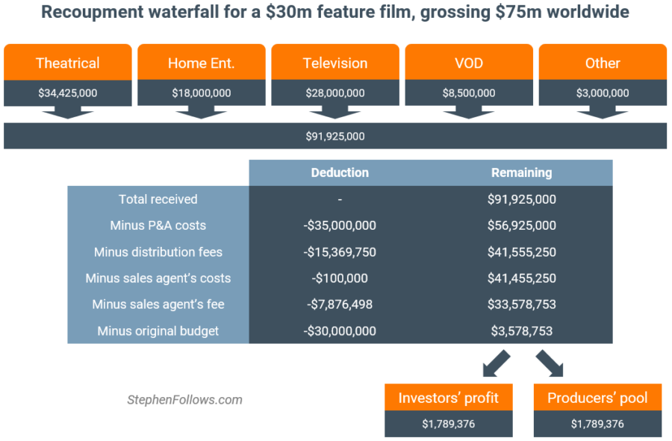

Slide 66
(2) Music
All money recoupable from the advance, including all production costs
Deductions taken from percentage of royalty - usually hidden.
Another Prob. = Establish the amount of Sales - Record Companies don’t want you in their books or their warehouse.
360̊ Deals - Make sure you get promotional commitment in writing.
PPD roughly double SRLP
RECORDED MUSIC DEALS
ASSUMPTIONS-Advance--$50k, Production Costs-- 30K
15% Royalty PPD = 7.5% SRLP
Price: $8.00 PPD/ 100,000 Units sold, so 800K Total Income to the Record Label.
(a) Deductions From the Income Basis Taken by the Label:
Deductions from the CD price:
(i) $2.00 - Packaging (25%)
(ii) $1.20 - Free Goods (15%)
(iii) $0.80 - Breakage (10%)
Subtotal - Royalty basis is $4.00 PPD x 100,000 = $400,000.00. So the Artist should get $60k, right?(15% Royalty x $400k). WRONG! Why Not? Royalty Deductions

Slide 67
(b) Royalty Deductions
The Artist’s Royalty is 9%---not 15% because:
(1) Royalty Reduced to 11.25% (New Configurations – 25% deduction), so 3.75% is deducted from the 15%
(2) Producer’s Royalty - 2.25% deducted, so Net Artist Royalty = 9%
So with the 9% Royalty the Artist should get $36,000?WRONG AGAIN! 35% reasonable reserve, so net eligible to be paid to artist = $23,400?
(c) 360 Deals
30% concerts, 25% publishing, 50% sponsorships/ merchandising.
Not included in gross receipts: free goods, program discounts, or AMOUNTS THAT THE RECORD COMPANY RECEIVES FROM ANCILLARY REVENUES ON 360 DEALS!

Slide 68
TOTAL GLOBAL Recorded Music Revenue
1999-$14.6 B—Peak Year
2006-$11.8 B
2013-2015-- $7B/YEAR
2016 - $7.7 B
2017 - $8.8 B
2018 - $9.8 B
2019-$11.1 B
2020- $12.1B
2021-$15B
2022-$16B Average of $0.0058/Stream or ½ penny per stream.
Physical Sales--$1.6 B($480M|CD and $1.2B|Vinyl)
Downloads--$214M

Slide 69
STREAMING ROYALTIES
ASSUMPTIONS-Advance--$50k, Production Costs-- 30K
15% Royalty PPD = 7.5% SRLP
50,000,000 Units Streamed and No Royalty Deductions
INCOME TO LABEL: 50,000,000 X 0.005 = $250,000.00
ARTIST ROYALTY: $37,500.00
UNRECOUPED AMOUNT = $12,500.00

Slide 70
NEW MEDIA RECORD DEALS
Streaming
(Record Company receives @52% / Streaming Service @ 48%)
The Average streaming Payment is $0.0058/stream (a little over 1 penny/stream)
Amazon- $0.00402/stream or $402 for a million streams. 55 M paid subscribers.
Apple Music--$0.00783/ stream or $783 for 1 million streams. 60 M paid subscribers.
Google/YouTube: $0.001/stream = $100.00 for 1M streams. 2023 Revenues= $29 Billion. 20M paid Subscribers. Pay 20% of Revenues vs. 67% Streaming Services.
Spotify: $0.00397 per stream or $397.00/ 1M streams. 120 M paid subscribers.
SoundExchange--@1/5 penny/stream/listener
Pandora Radio: 0.0013/stream/ $1,300.00 for a million streams
Music Publishers—13.3% of net revenue or 24.1% of the total content cost, whichever is greater. Record Co. receives @ 52% of net revenue from streaming 15.1% of revenue paid to music publisher.
Songwriter $600.00/1 million streams (1/5 of label)| $0.06/ 100 streams or $0.006/stream
DEDUCTIONS: 1) Excess mechanicals, 10 songs @75% rate—some album deals require 14 songs! 2) Producers Royalty
Entitlement to payments, getting paid
SX – receives @ 1/5 of a penny per listener – 45% to featured artist, 5% non-featured, and 50% - rights owner

Slide 71
THE Things THAT You Should Know About Your Final
Final Exam Review
1. Most difficult final - Easy to please with great work. No tricks, but read the question carefully. Lots of time to answer.
2. As per syllabus – Open book, Seven (7) true/false question/essay explanation—10 Points Each. One question can be answered in one sentence. Worst essay answer will be disregarded.
Ten (10) multiple choice – 4 points each.
3. Presented with fact pattern like you might encounter as a lawyer.
4. Take a position and defend it. (Like the bar exam) (Lawyers v. Professors). We will grade based on the quality of your answer and not its length.
5. Answer the question ASKED, then explain just like app. court. Don’t go off on tangents, just to show me that you know stuff. Not relevant to the question. I have a low BS threshold.
6. Write like Hemingway not Fitzgerald. Short, concise declarative sentences. Long answers are not necessarily the best answer.
7. Class discussions are fair game, book and Web-Board if discussed – Rap-A-Lot

Slide 72
Jack Higgins Case, Septemberbride v. Stein, Author’s “Loan Out” Company not being paid its installment advances and tried to rescind Contract. Court held that:
(a) Default in payments is not equal willful misconduct as to justify rescission
(b) Author was entitled to be paid his royalties, before publisher’s creditor was paid
In Re Waterson where the court denied a receiver’s application to sell a music catalog free and clear of royalties, based on the new publisher’s implied duty to work the copyrights and the former publisher’s equity.

Slide 73
Discussed the reasons and purposes of negative injunctions, which require that the Artist’s services be:
(1) Exclusive; and
(2) Unique
Example:
Rogers v. Comstock Case where the Court aff’d a negative injunction because the star performer’s services were unique, as evidenced by the Contract language and facts of the dispute. Court also held that a negative injunction could be applied against the company inducing the breach. Cites Lumley v. Wagner –the Opera Singer case.
TEXAS—Mission ISD v. Diserens, 188 SW2d 568 (Tex. 1945). Music Teacher Case. Follows Lumley v. Wagner
Factors considered by Courts in deciding whether to issue negative injunctions:
(1) Uniqueness of the services;
(2) Irreparable injury;
(3) Undue restraint/reasonableness of the injunction. Artist has to be able to make a living and not have to go back;
(4) Investment in talent made by the company; and
(5) Competitive impact among firms – competitors have a better chance of success.
California injunction legislation requiring that Contracts have a minimum guaranteed compensation which can’t be in the form of an option. (No equivalent in Texas)

Slide 74
Motown v. Tina Marie Case, where Motown exercised the option to pay $6K after the termination of the Contract. Court held that the consideration requirement not met simply by the exercise of the option.
Court also distinguished the Olivia Newton-John Case, where the Court held that the consideration requirement HAD been met, where Olivia Newton-John had control over the recording budget, but the injunction was limited to the term of the Contract.
Damages for breach of Contract
Quinn v. Straus Broadcasting – DJ sued the radio station for wrongful termination, over $1.5 million in damages, The Sky, The Moon, and All the Gold Looted in Baghdad, because of the damage to his personal reputation. Court held that the reputation damages weren’t proven since he’d taken another job and were too speculative in any case.
PLO Supporter Vanessa Redgrave had a little more luck in her case against the Boston Symphony. Court held that her consequential damages were within the contemplation of the parties when they entered into their Contract, but limited them to one performance where her testimony was backed up by a producer. Received a whopping $12k, less expenses, plus her $27,500. fee. Was offered $30K before the litigation.

Slide 75
Shirley MacLaine was more successful than PLO Vanessa in her case, Parker v. 20th Century Fox, and was held to be entitled to compensation under her contract to perform in “Bloomer Girl,” even though she was offered and turned down a gig to play a Western opposite Sean Connery. She obtained a Summary Judgment, upheld on appeal, on the basis that the Western was not the “equivalent” or “substantially similar employment,” to the Bloomer Girl Musical.
Raquel Welch was also successful in her case against MGM, where she was able to obtain damages as a result of being fired from the film “Cannery Row,” based on expert testimony. But her damages were reduced based on the California Supreme Court’s decision that the breach of the implied covenant of Good Faith and Fair Dealing” is a contract action not a tort, cause of action.
THE KIGGUNDU FILES

Slide 77
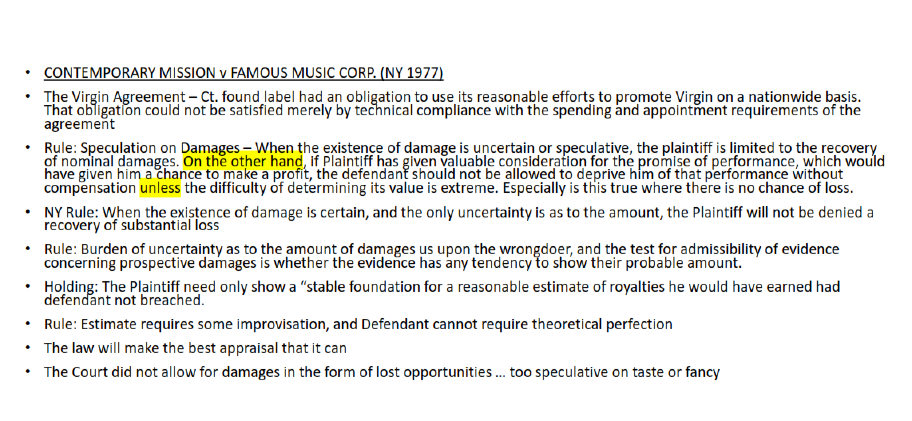

Slide 80
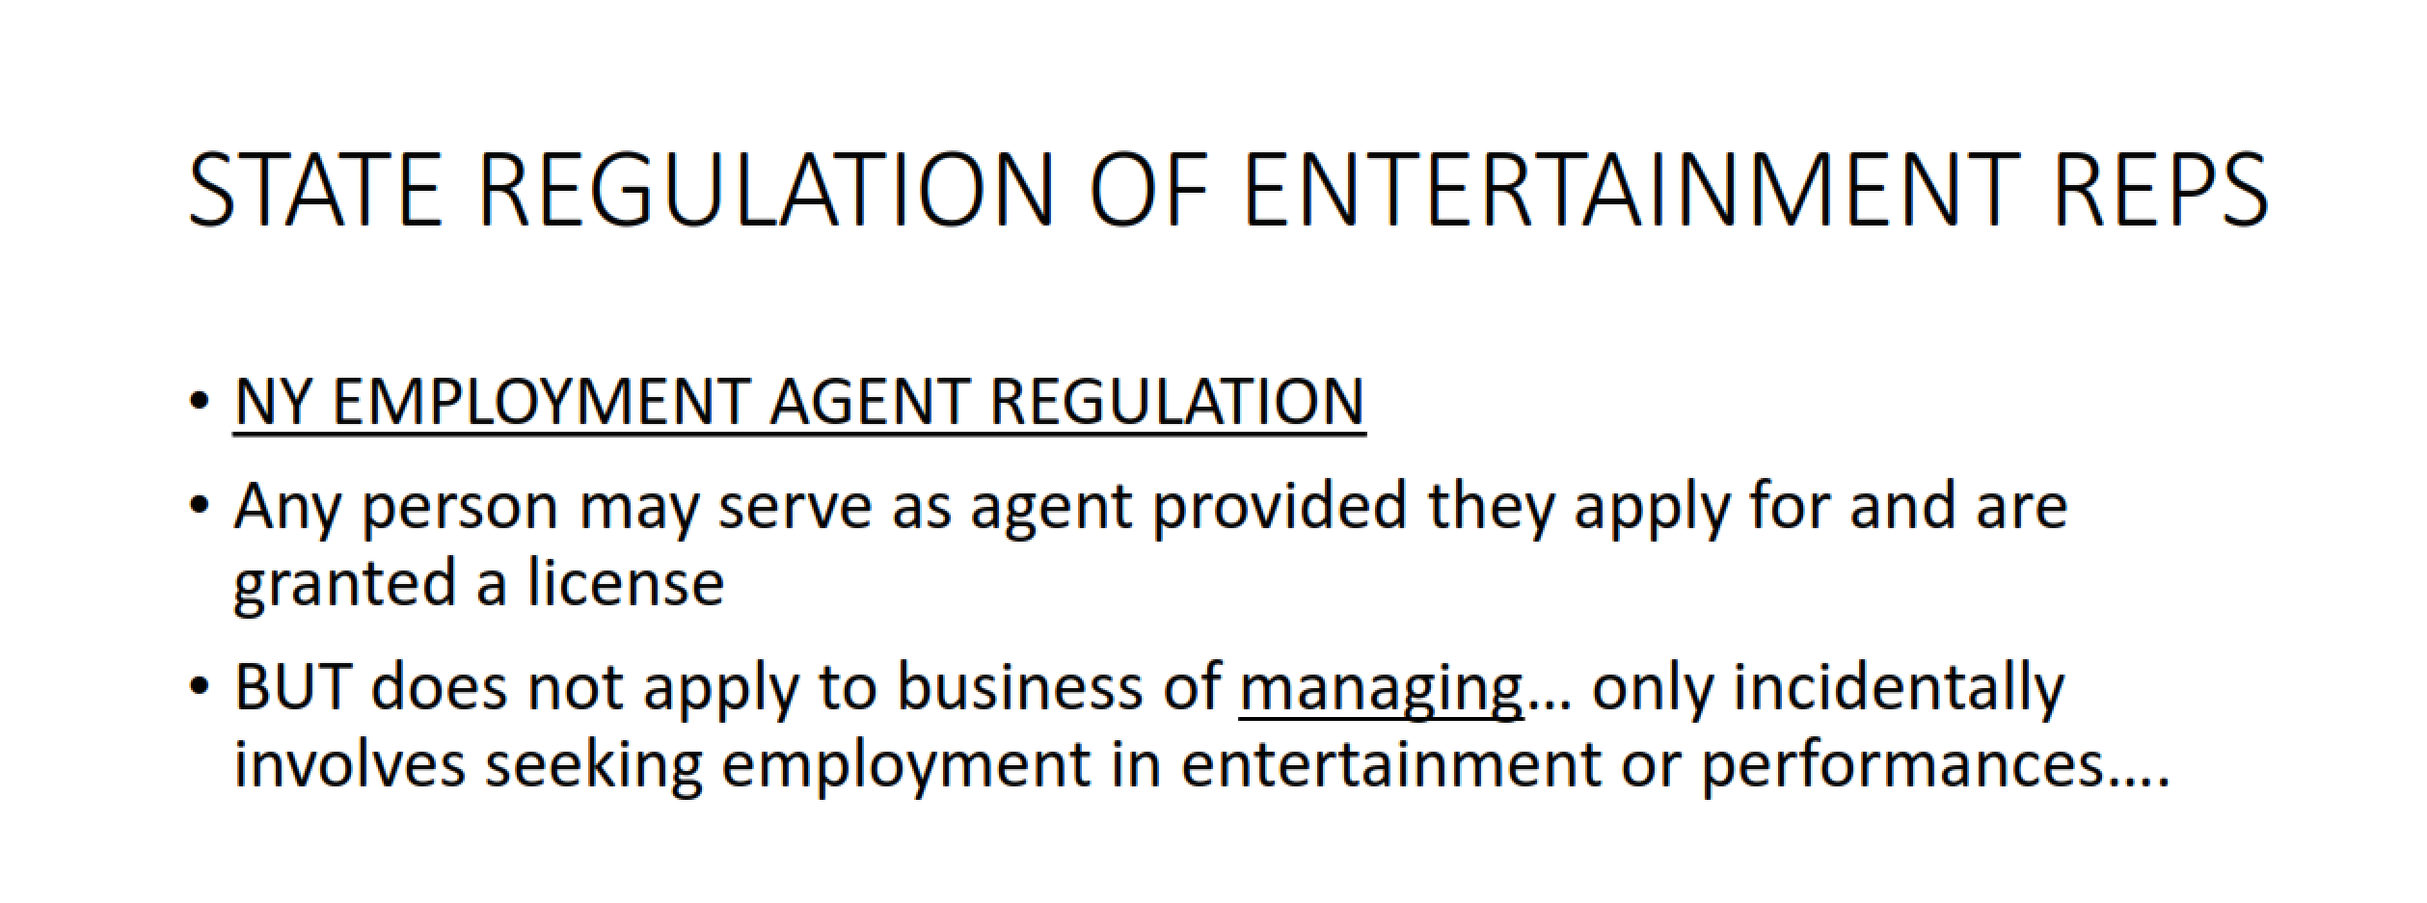

Slide 81
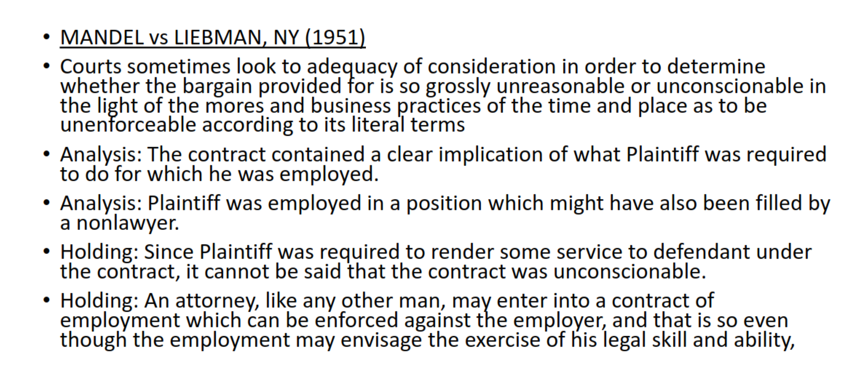

Slide 82
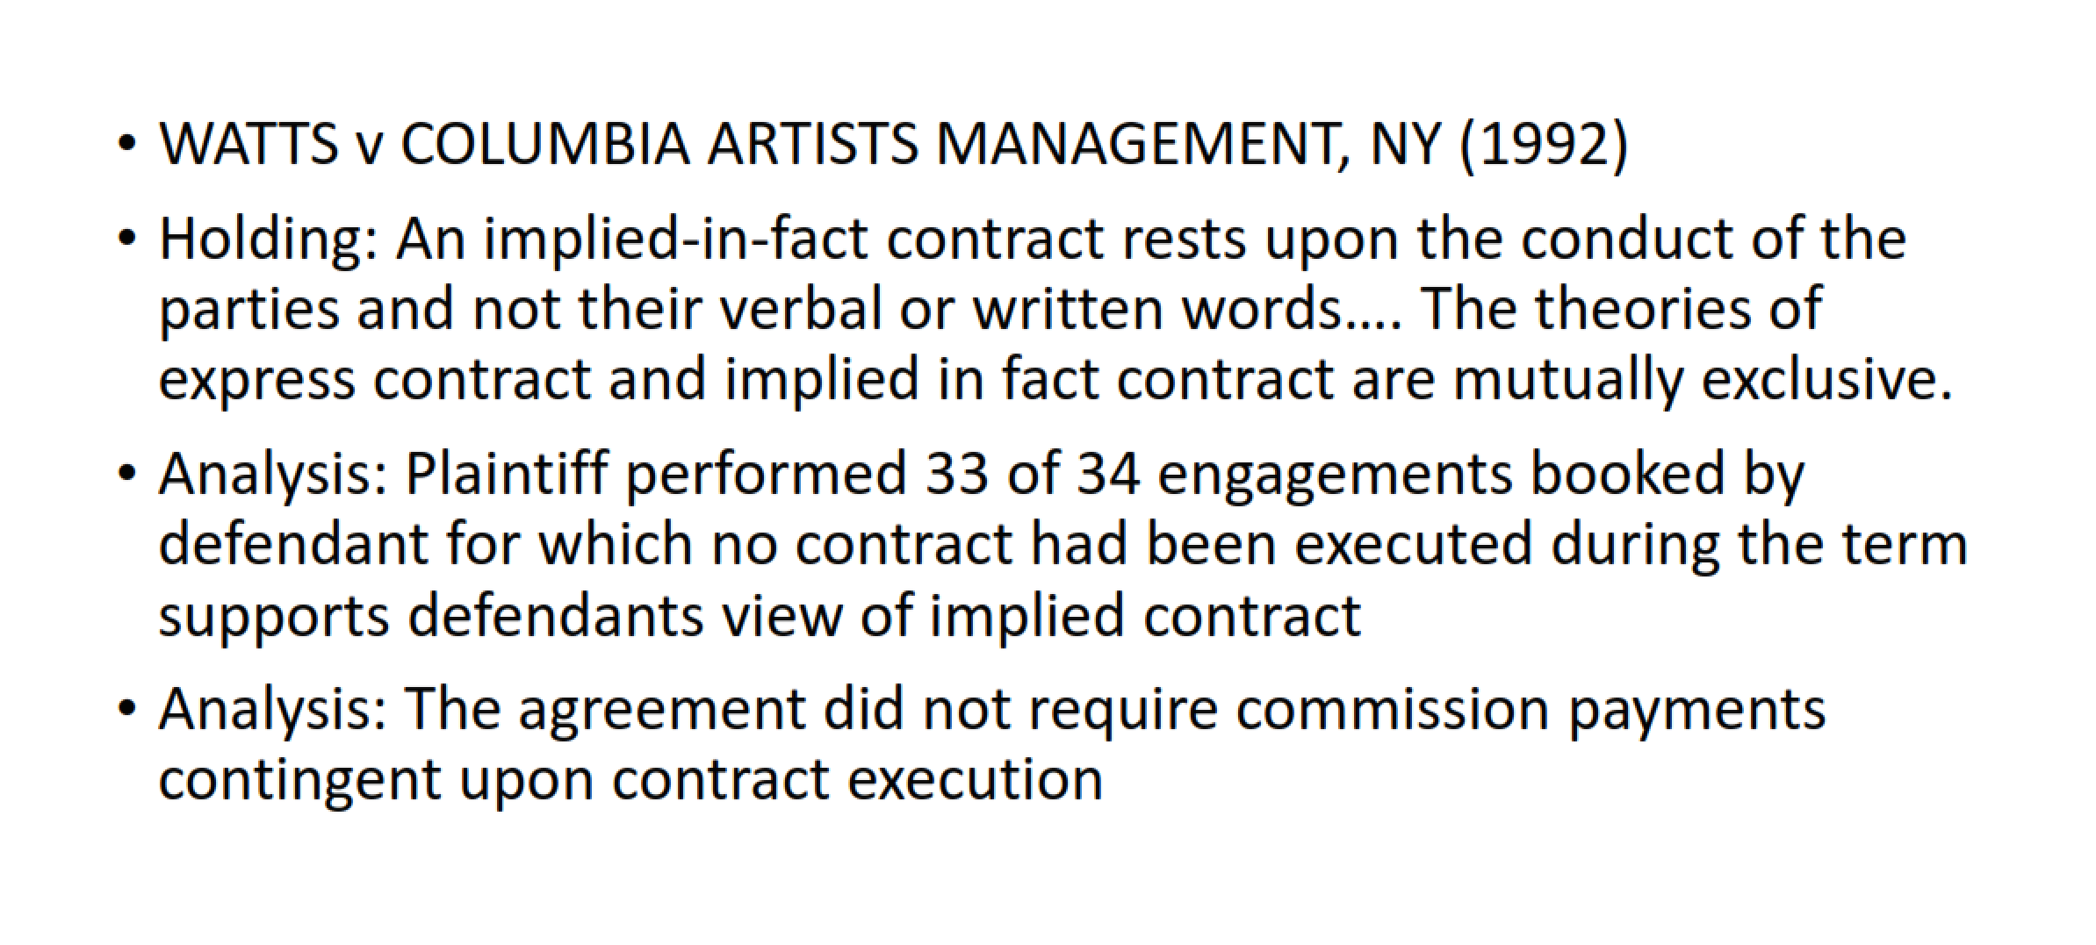

Slide 85
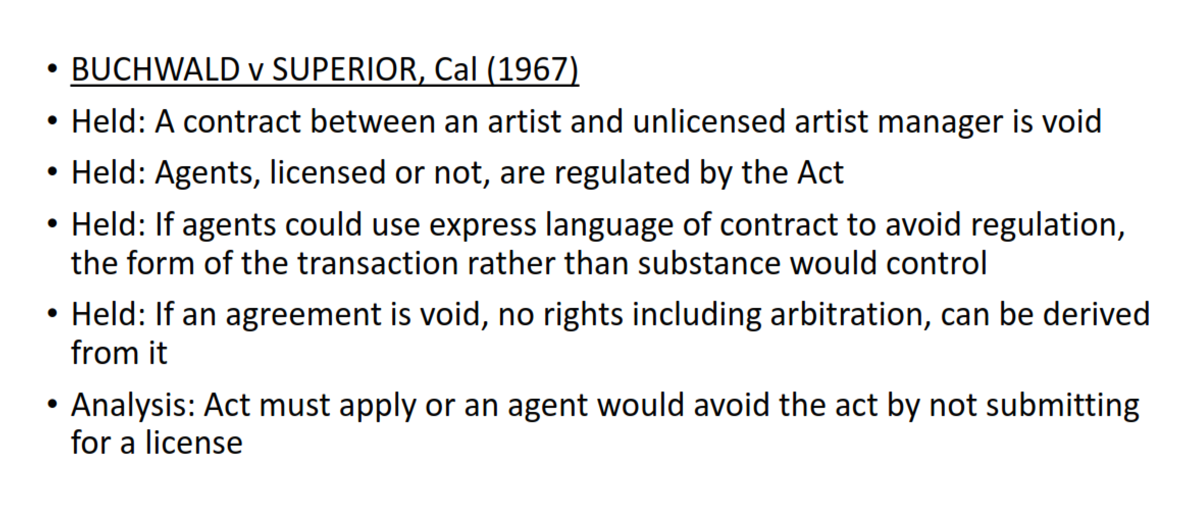

Slide 86
In the book publishing arena, we covered Freund v. Washington Square Press, where the publisher refused to publish the author’s manuscript. The court held that his contract would entitle him to his loss of royalties, and the return of his manuscript but NOT the publisher’s cost of publication. However, since the royalties were too speculative, he was entitled only to nominal damages.
However, all is not lost for Authors and Artists as we saw in the case of Contemporary Mission v. Famous Music Corporation where the Plaintiff, who were priests, perhaps had divine help, but certainly had the help of a good lawyer who was obviously not a Virgin to the music biz. The priests’ lawyer wrote into the contract specific promotional obligations of the record company. The priests proved substantial damages arising out of the breach of contract. When the record company appealed, the priests also filed a cross-appeal in order to obtain even more damages based on a statistical analysis of potential sales, which evidence had been excluded by the trial court. However, the Court did not allow the priests any lost touring income. To be continued.

Slide 87
ENTERTAINER REPRESENTATION AND REGULATION
TALENT AGENTS—BOOK EMPLOYMENT AGREEMENTS FOR ARTISTS AND AUTHORS AND RECEIVE A 10% COMMISSION, BUT MUST BE REGISTERED IN CALIFORNIA, NEW YORK, AND OTHER STATES. TEXAS’ TALENT AGENCY STATUTE WAS REPEALED IN 2011.
MANAGERS—DO EVERYTHING ELSE, AS WELL AS SECURE RECORD DEALS FOR ARTISTS, AND GENERALLY RECEIVE A COMMISSION FROM 15-25%
LAWYERS: DO EVERYTHING EXCEPT ACT AS TALENT AGENTS, IN EXCANGE FOR AN HOURLY FEE, A CONTINGENT FEE, OR A FLAT FEE. NO STANDARD FEE.

Slide 88
MANDEL v. LIEBMAN—Atty contracted to act as personal representative and manager in exchange for 10% of Author’s gross earnings. Atty sued to enforce his compensation arrangement after Author fired him. The Court held that the contract did not lack mutuality, did not require the Atty to have a talent agent license, and was not unconscionable. It was therefore enforceable.
In Texas, Mandell & Wright v. Thomas, 441 Sw2d 841 (Tex. 1969) allows attorneys to obtain their full contingent fee if terminated without cause, ie. Not limited to quantum meruit recovery.
RADEN v. LAURIE—Minor Actress terminated Manager under agreement to provide advice and business counsel. After Manager was fired, he sued for his commission. The court rejected Actress’ claim that the agreement was void because the Manager did not have a license, reasoning that there was no duty to obtain employment under the agreement and there was no evidence that the agreement was a sham. c/f. Buchwald v. Superior Court, where the Jefferson Airplane both pled and proved that the Manager was required to be licensed because he was in fact acting as an agent, regardless of the K language.

Slide 89
WACHS v. CURRY—the Arsenio Hall case. After Hall terminated his Atty/manager/agent for receiving undisclosed fees, the Atty was required to disgorge all compensation that he had received despite the fact that Hall had: 1) knowledge that the Atty was acting as an agent; and 2) approved the arrangement because it saved Hall money. The Attys defenses of waiver and estoppel were rejected.
WAISBREN v. PEPPERCORN PRODUCTIONS-CONTRARY TO WACHS v CURRY, held that in California, Managers must be licensed even if they devote only minimal or incidental portions of their activities to procuring employment.
PARK v DEFTONES—even though record deals are excepted from the Cal. Talent agent law, the K was held to be void where the Manager also booked concerts, ie. Procured employment.
The WORKAROUNDS— WESLEY SNIPES v DOLORES ROBINSON -SIMPLY HAVE A MANAGER WHO PERFORMS SERVICES AT TALENT AGENT’S REQUEST—EVERYONE GETS PAID! SHARON STONE—Have the Studio hire the Manager as a Producer. Anyone can be a Producer!

Slide 90
CONFLICTS OF INTEREST IN ENTERTAINMENT LAW
The FOUNDATION of conflicts law is the duty to safeguard your clients’ secrets. THE INHERENT PROBLEM: Artists want “connected” Attys but connected attys may have conflicts of interest that compromise their independent judgment. Because the practice of law is a profession and not a “regular” business Attys have ethical responsibilities above those that are required in business.
THE RULES: ABA RULE 1.7 AND TEXAS RULE 1.06(e)—Attys cannot represent any interests that are “directly adverse” to their clients. This basically means that your independent judgment cannot be adversely affected or materially limited.
Generally, to be a client, there must be privity of K (Draper v. Garcia, 793 SW2d 296 (Yocel’s case). Exceptions are client consultations even when the Atty is not retained and torts such as negligent misrepresentation(McCamish. 991 SW2d 787 (Tex. 1999).

Slide 91
Doing business with Clients is ethically—and financially—very risky. If there is a dispute any agreement with the client is presumed to 1) unfair and 2) favor the Atty. Acher v. Griffith, 390 SW2d 735 (Tex. 1964).
CROCE v. KURNIT—THE MOST WELL-KNOWN CASE. After rock star Jim Croce died in a plane crash, his wife sued his best friend, his record company and the lawyer who had secured and negotiated the record deals that catapulted Croce to stardom. The Court held that the record deals were “hard bargains” but not unconscionable. However, because the Atty was introduced as “the lawyer”, did not make clear who he was representing, and did not advise Croce to seek independent counsel, the Atty was held to have breached his fiduciary duty and ordered to pay Wife’s court costs and attys fees.

Slide 92
Texas law provides for atty fee forfeiture for “clear and serious violations” of the atty’s fiduciary duties. THE CLIENT NEED NOT SHOW CAUSATION OR DAMAGES. ARCE v. BURROW, 977 SW2D 229 (TEX. 1999).
ABKCO v. HARRISONGS—The Beatles’ sleazy manager “switched sides” in the “MY SWEET LORD” CLASS AND TRIED TO SHAKE GEORGE HARRISON DOWN ON THE SETTLEMENT. THE COURT FOUND THAT THE MANAGER HAD COVERTLY—AND WRONGFULLY—SHARED CONFIDENTIAL INFORMATION WITH THE OTHER SIDE. BECAUSE THIS WAS A BREACH OF THE MANAGER’S FIDUCIARY DUTIES, THE HARRISON DID NOT HAVE TO PROVE CAUSATION FOR HIS DAMAGES AND IMPOSED A CONSTRUCTIVE TRUST ON THE FRUITS OF THE WRONGFUL DEAL MADE BY THE MANAGER.
LAWYERS AND MANAGERS BREACH THEIR FIDUCIARY DUTY WHEN THEY MAKE SECRET SIDE-DEALS.

